Slide 1
Airbnb Listing Price Feature Selection Analysis
Teena Gupta, Zhenni Liu, Conrad Ning, Bangyang Qiu, TJ Tolliver
Team 5A

Slide 2
Table of Contents
01
02
03
Introduction
Dataset
ML 1
04
05
06
ML 2
ML 3
Business
Implications
Why does this topic matter?
Summary & EDA
Linear Regression
Ridge Regression
Random Forest

Slide 3

Introduction
Real Estate Investment
Diversify Investment
Leverage Asset
Passive Income
Monthly Revenue > Operating Cost
Notes:
I believe most if not all of us have heard of Airbnb from the customer end, but what does Airbnb mean to millions of hosts worldwide?
Airbnb and other short term rental platforms created a new way for people to invest in real estate. Before, investors looked for renters who agreed to sign longer contracts. Now, with the help of Airbnb, both the host and the guest would feel secure about a “short term” transaction.
Real estate investing brings a lot of value to the investors. It diversifies one’s investments, helps people leverage their current assets and turns them into more money in the long run, and most importantly, it generates long term passive income for the foreseeable future. This business model would only be practical if the monthly revenue exceeds the operating costs, and what determines the monthly revenue?
Let’s find out by looking at our dataset!

Slide 4

Dataset
Summary
Cleaning
> 40,000 Listings in LA
“Price” & “Availability”
String -> Float
Remove Null Value & 0
Preprocessing
ML Models
Standardization
Data Binning
Linear Regression
Ridge Regression
Random Forest
Notes:
Our dataset consists of over 40,000 Airbnb listings in LA County, and over 80 different (Variables)columns differentiating all the listings, making them all unique. Out of all the factors, we decided to pay close attention to “price” and “availability” since they are the two most important when it comes to calculating the monthly revenue.
Next, we cleaned our data by converting some string values to float values, and removed all rows of data with any null values along with any 0 values.
As of data preprocessing, our team tried data standardization and data binning, and after looking at the evaluation metrics, we decided to use data binning for our project.
The machine learning models we used for this project were linear regression, ridge regression, and random forest. I would add a brief description of why we used these- ie: best fit for our data, most likely to provide x insight etc.

Slide 5
Exploratory Data Analysis Visualization

Slide 6
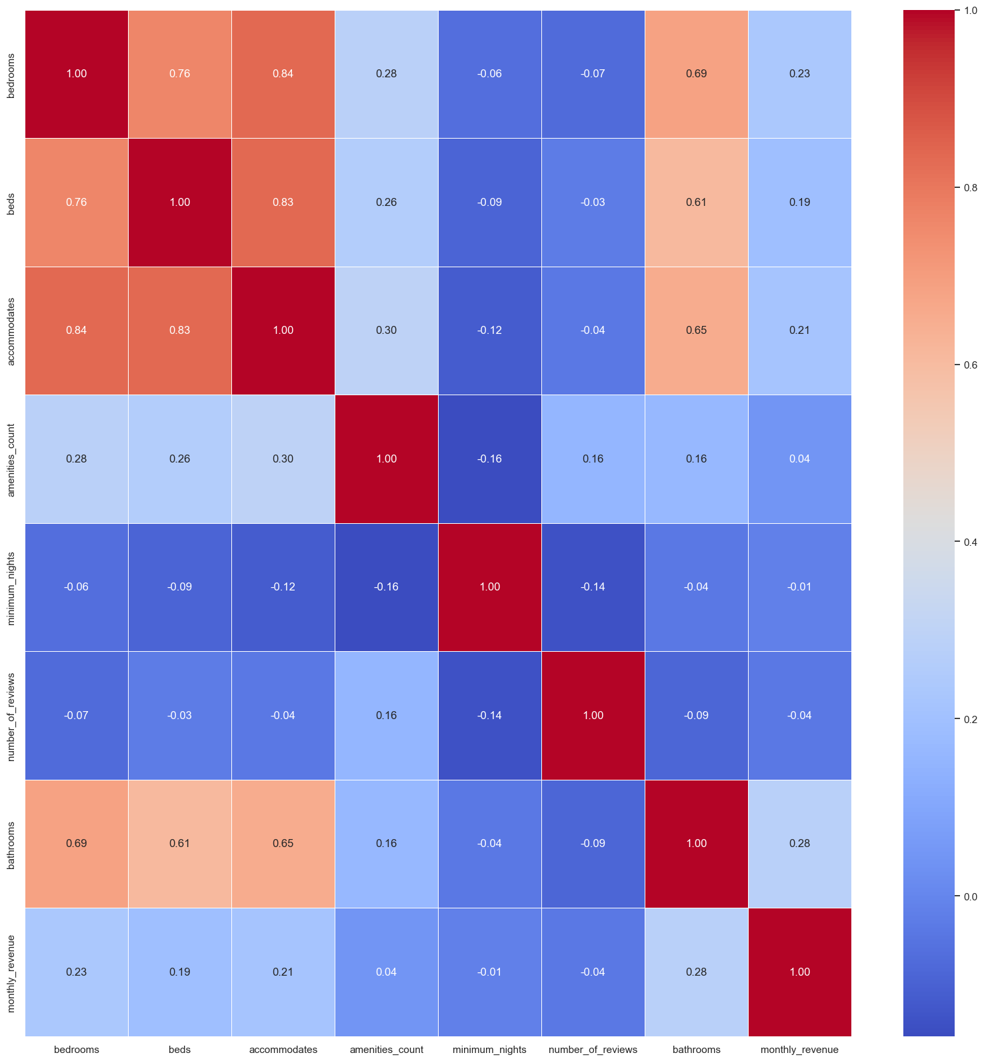
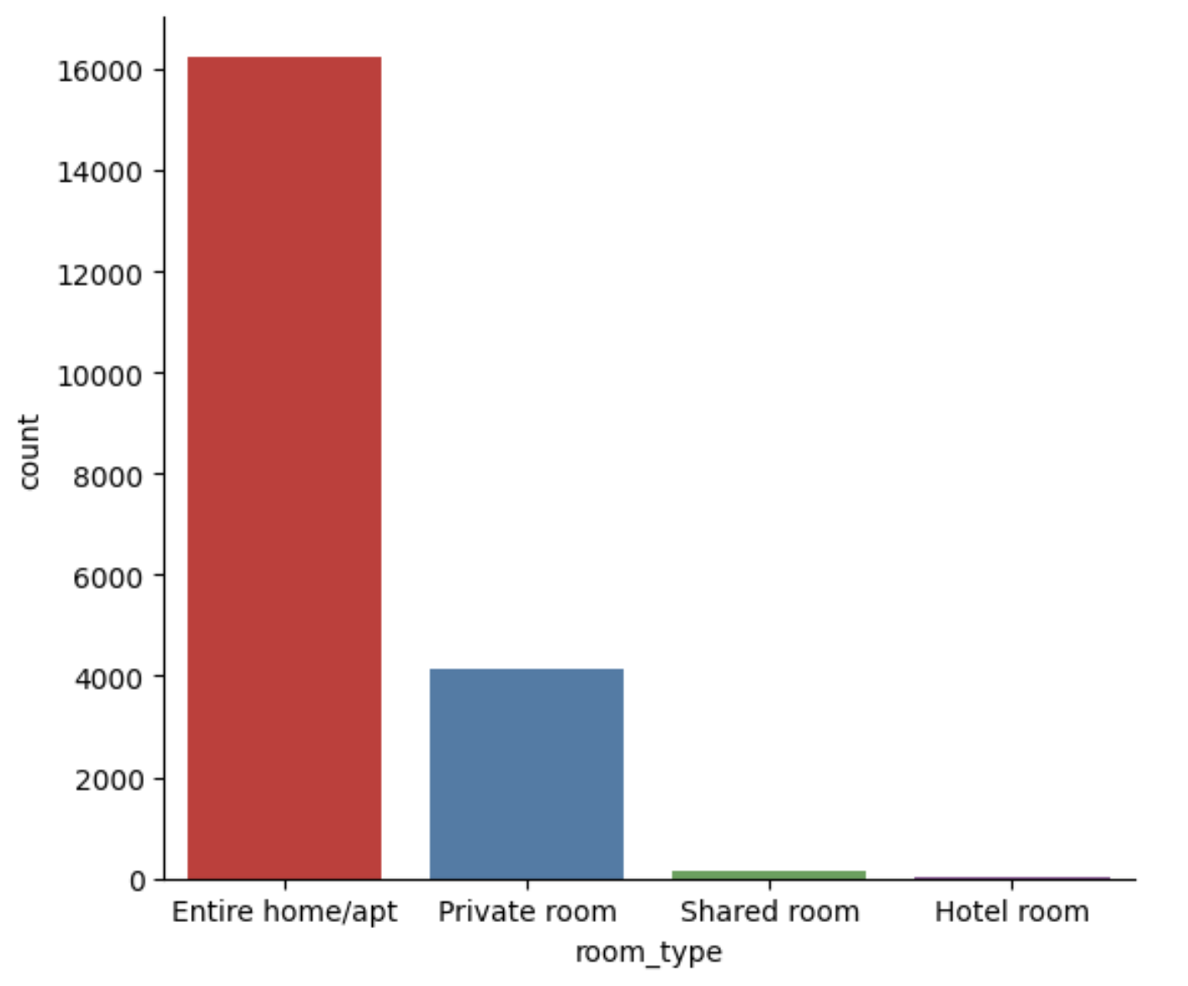
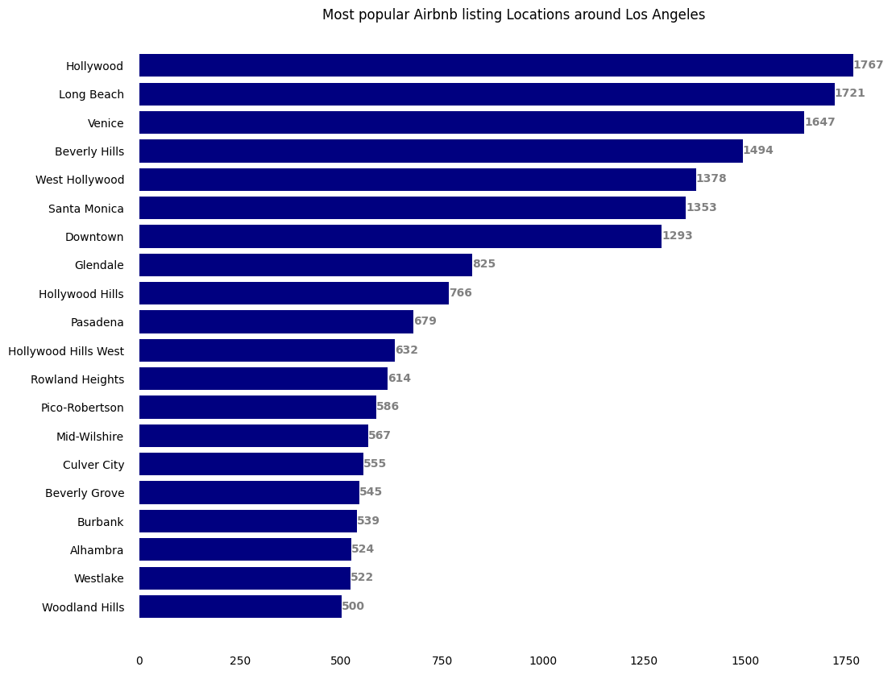

Slide 7
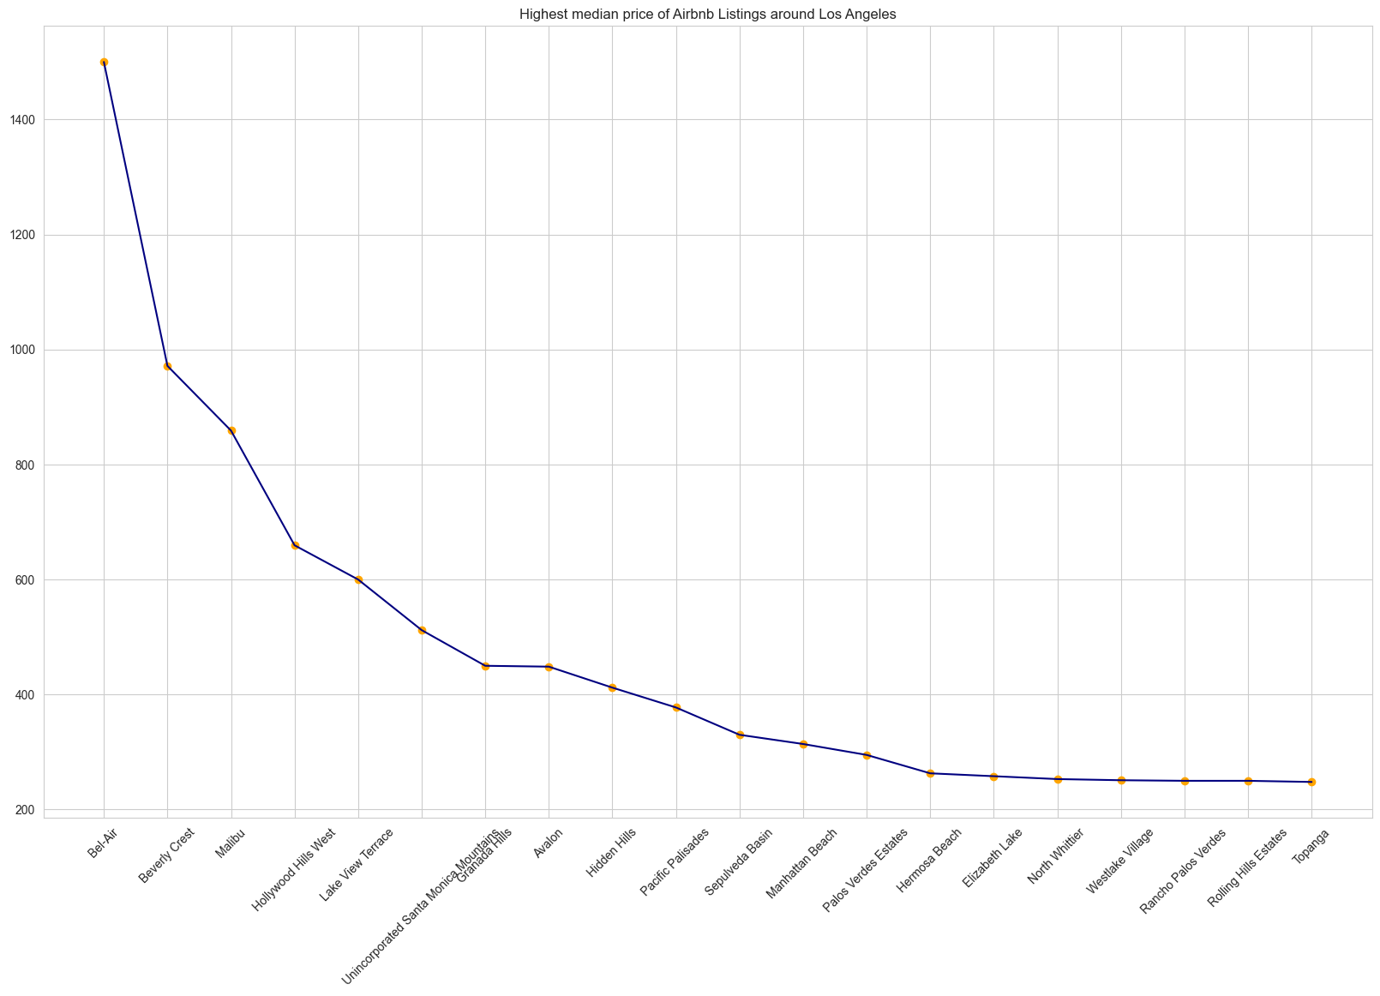
145,245
Big numbers catch your audience’s attention

Slide 8
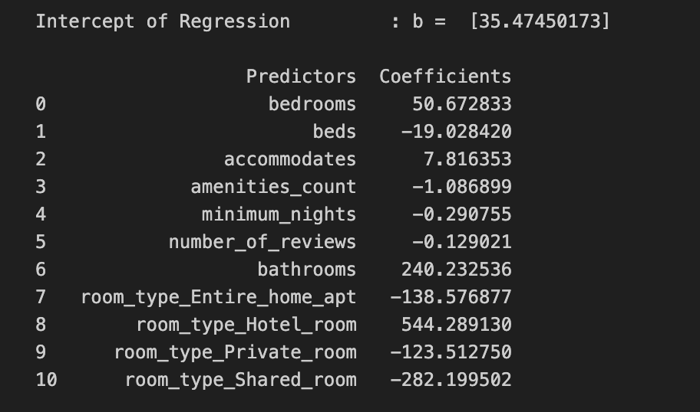
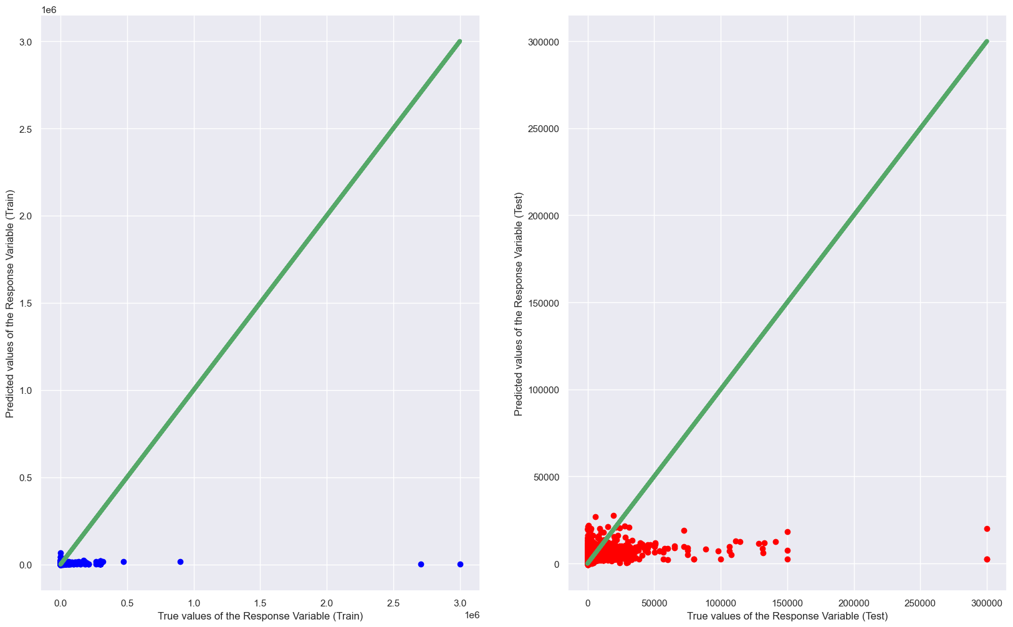
ML Model 1
Linear Regression

Slide 9
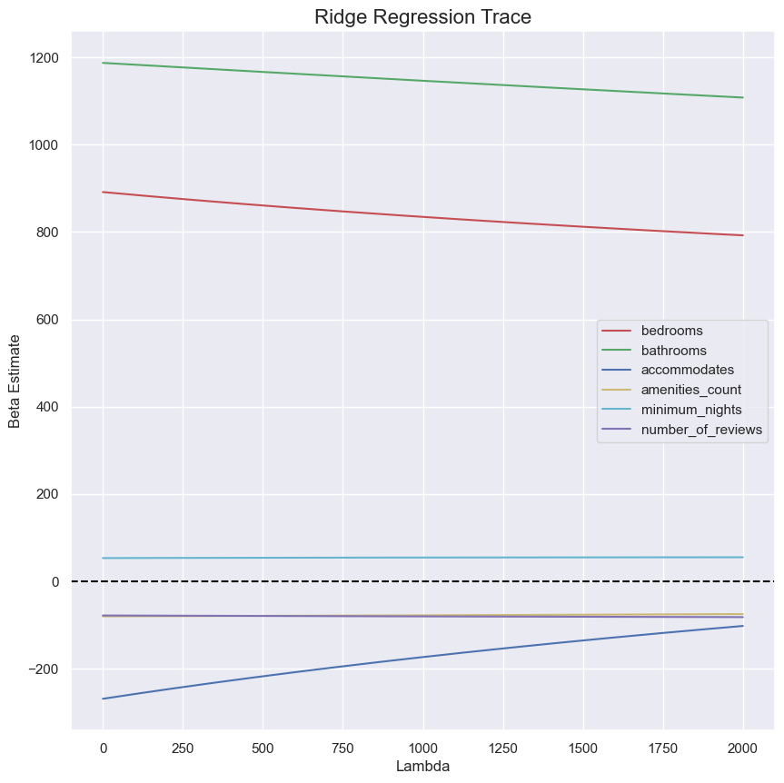
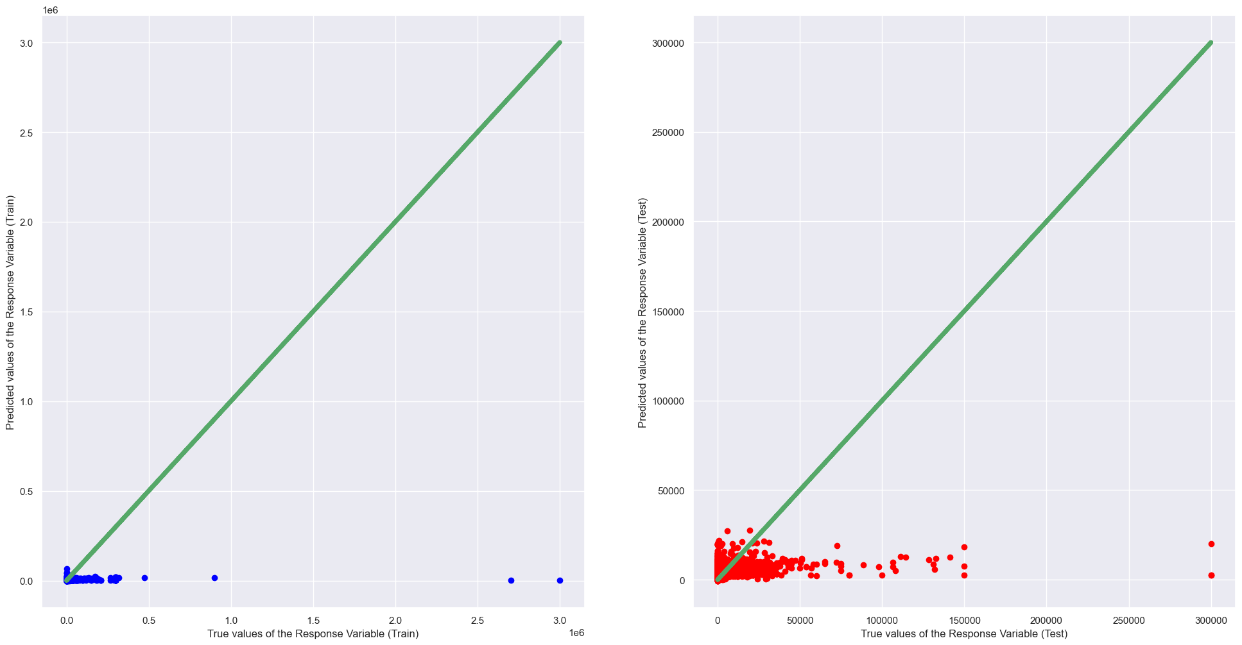
ML Model 2
Ridge Regression

Slide 10
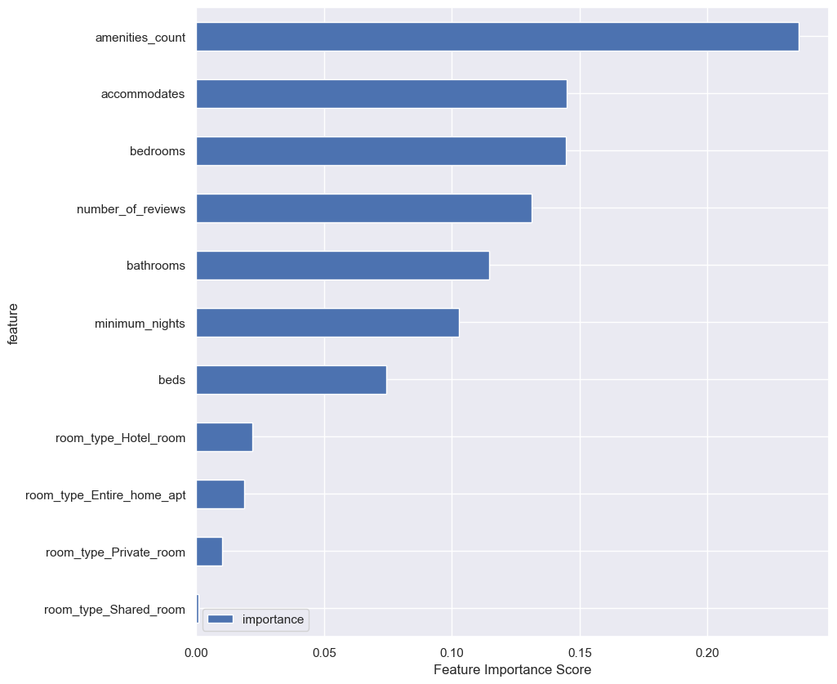
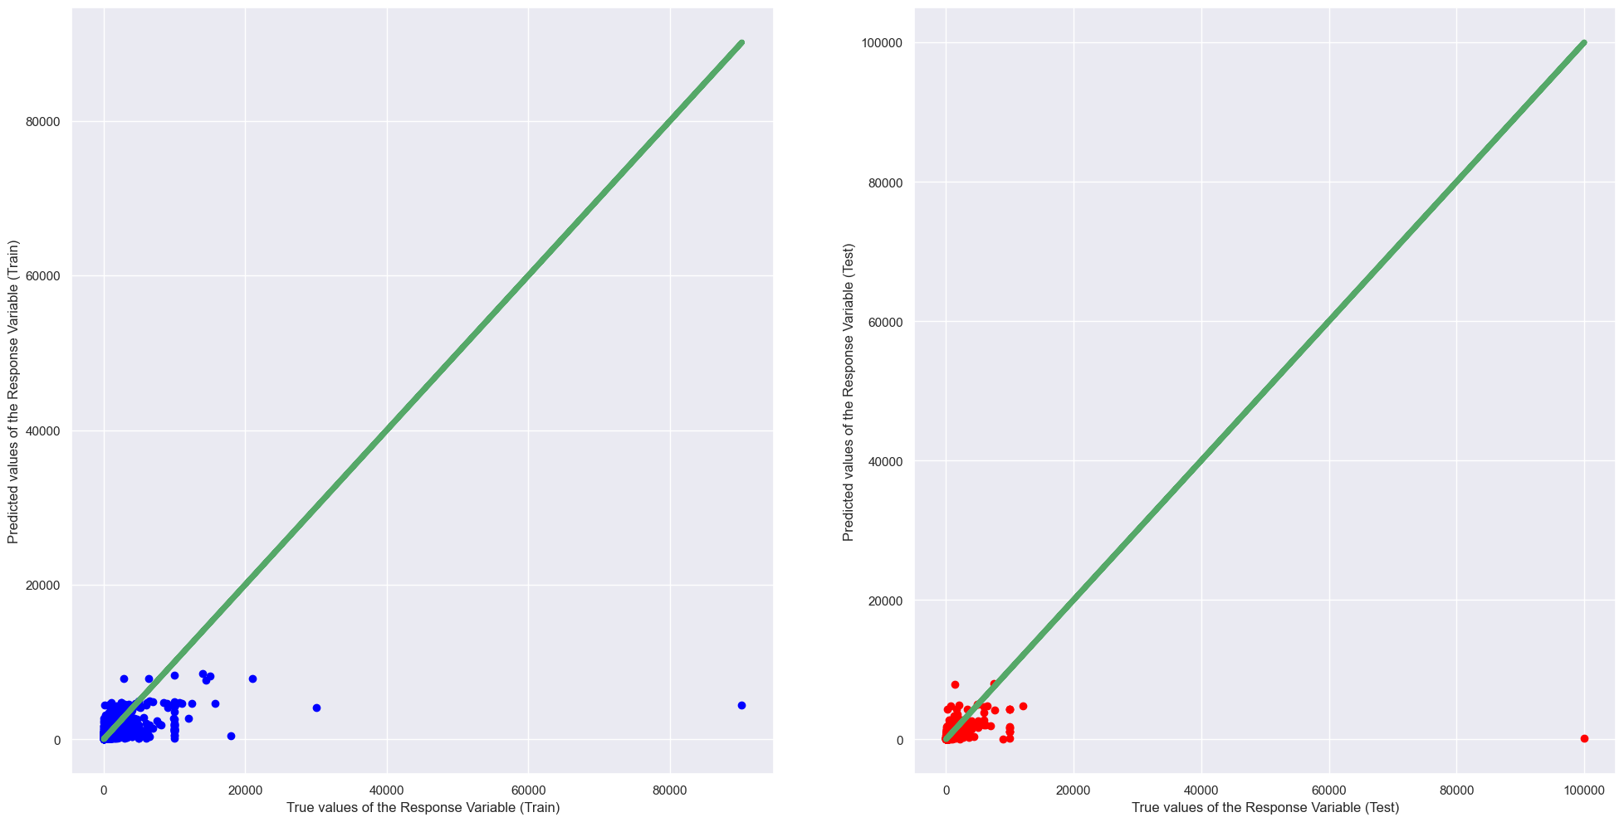
ML Model 3
Random Forest

Slide 11
Evaluation Metrics:
MSE & R²

Slide 12
Prior to Pre-Processing
01
MSE: 58259257.22
R2: 0.07259230061576227
Linear Regression: Most Accurate
02
MSE: 58264306.5243267
R2: 0.07251192254342231
Ridge Regression : Tied for Most
03
MSE: 152600638.32085696
R2: -1.4291934650550409
Random Forest: Least Accurate

Slide 13
Post Pre-Processing
01
MSE: 3246.88923
R2:
Linear Regression: Most Accurate
No Real Improvement
02
MSE: 3255.989222
R2:
Ridge Regression : Tied Accuracy
No Real Improvement
03
03
MSE: 45678.2345555
R2:
MAE: 3270.5636078640587
MSE: 152600638.32085696
RMSE: 12353.163089705282
R2: -1.4291934650550409
Random Forest: Least Accurate
No Real Improvement
Random Forest: least accurate

Slide 14
Business Implications
Linear Regression
Ridge Regression
Random Forest
Hotel Rooms provide highest income
Amenities Count most important
Amenities and Bathroom count most important
Recommendation:
Do not invest in Airbnb’s in the Los Angeles Market.
If you do:
Have a lot of Bathrooms and Amenities!
Notes:
TJ- So what does all this processing and evaluation mean in real world terms?
For our linear regression, our most important factor is that our hotel rooms provide the highest income
Ridge regression shows that Amenities are one of the most important factors
Random Forest confirms that Amenities are important and also shows that Bathroom count is nearly as important.
With our processed data showing such a low monthly revenue average for our los angeles Airbnb data, we can strongly recommend those who are interested in investing in short term rentals do not do so in Los Angeles County.
Or if you do make sure people can keep themselves occupied using lots of amenities…. Or bathrooms
( this is a joke) .

Slide 15
Thanks for Listening
Questions?

